Slide 1

Tote Store
Mobile Stores. Simple

Slide 2
Apps build and imbed customized, mobile stores with the Tote Platform.

Slide 3
“We knew we could do what most people aim to do every day: avoid ads”
— Jan Koum, WhatsApp

Slide 4
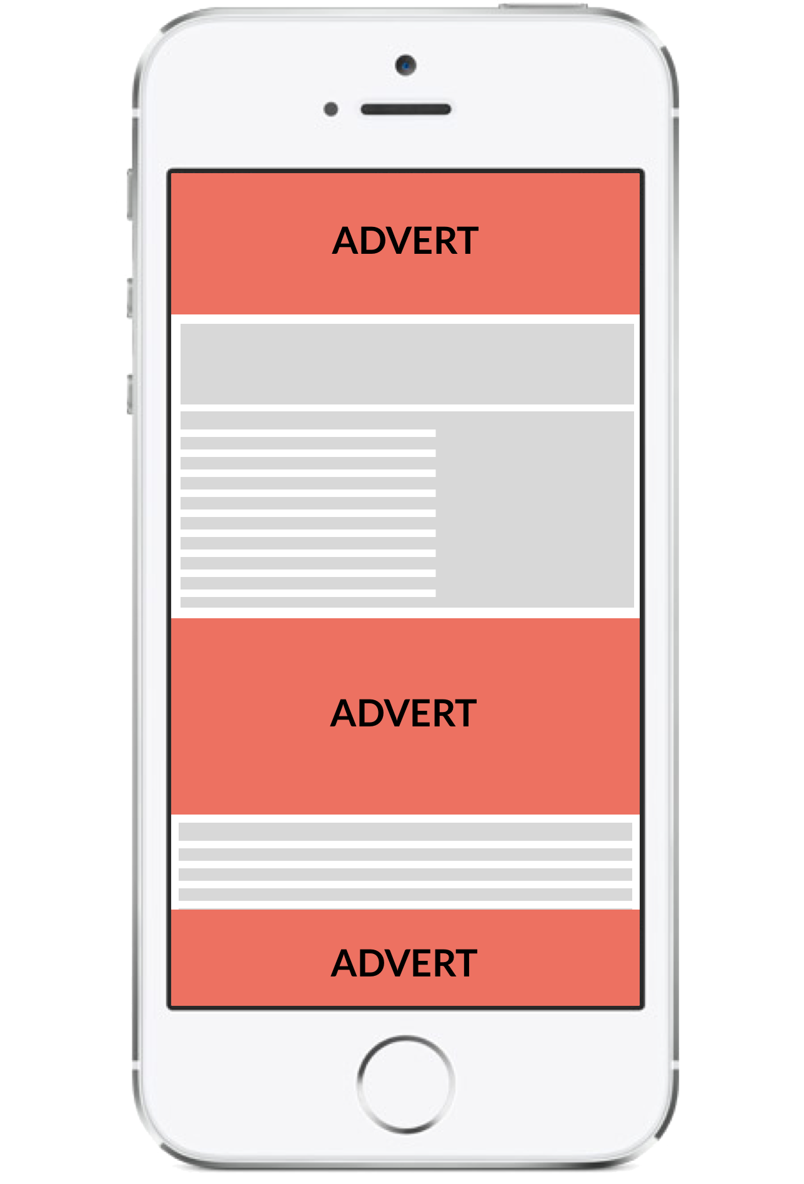
Because mobile ads detract from the user experience

Slide 5

Apps forgo ad revenue to focus on user growth...

Slide 6
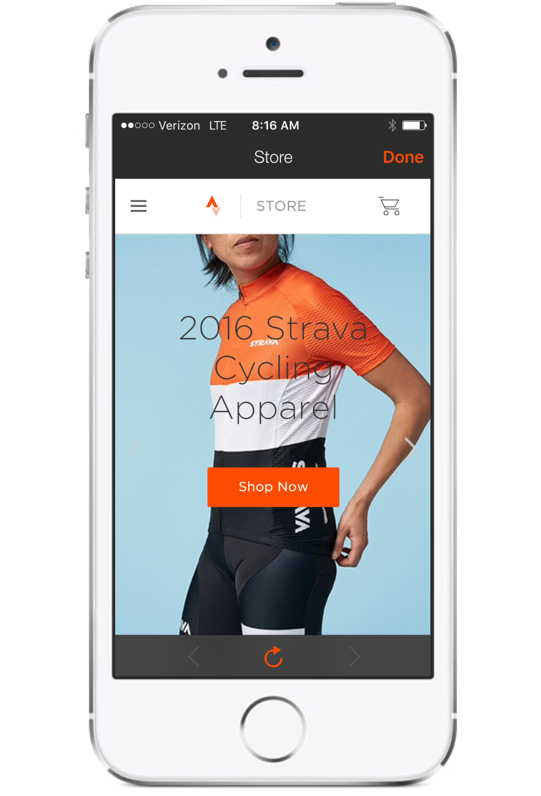
Some apps sell products directly, but this requires substantial overhead.

Slide 7
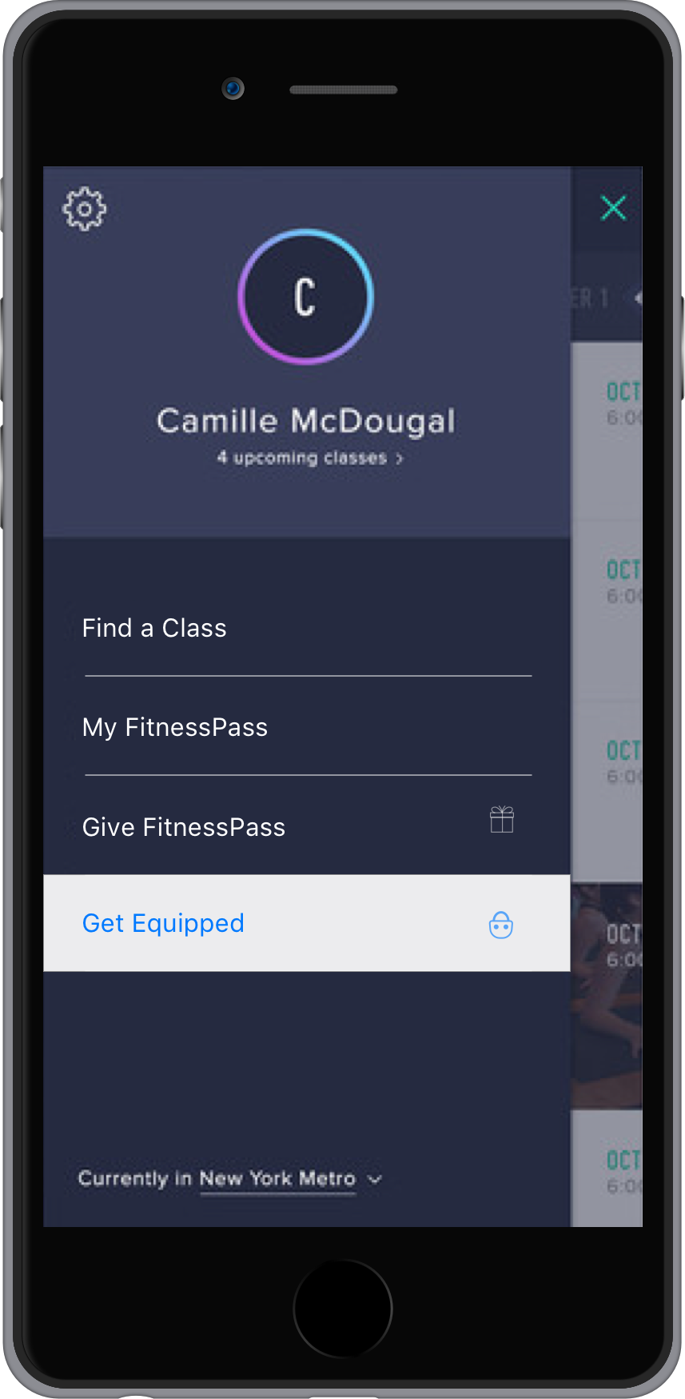
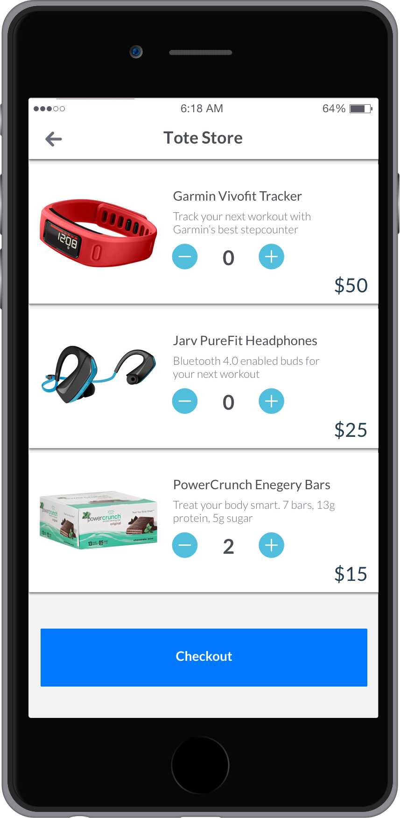
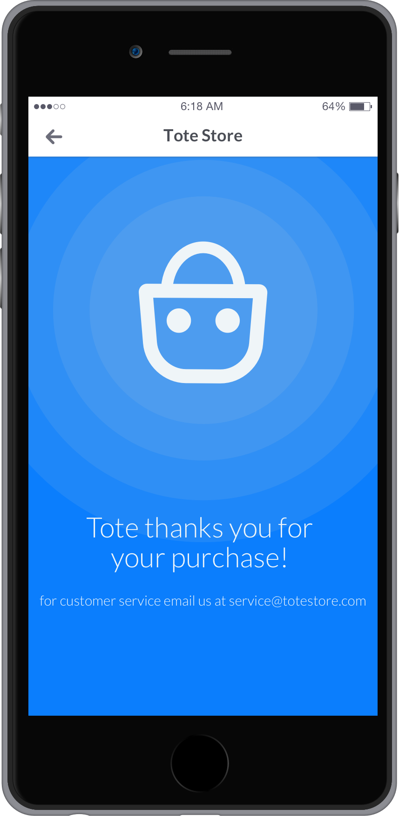
Introducing Tote: a platform for easy-to-implement, mobile stores— as a service

Slide 8
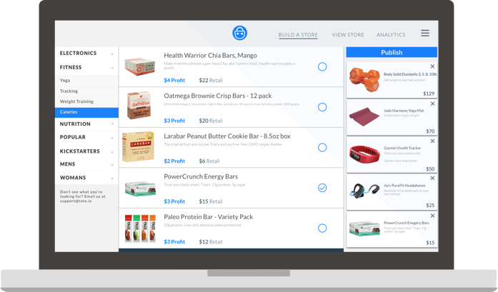
Apps can create, update and imbed stores in minutes.

Slide 9
Brand Positioning
Bolster brands: apps sell products that enhance their service; e.g. yoga scheduling apps sell yoga products
Increase conversions: apps are best positioned to select and serve products to their users
Convenience purchases: order the goods you need when you are most engaged

Slide 10
The Platform
Single-point access to mCommerce: for sellers, Tote is a single point to access millions of mobile users and capture the ‘move to mobile’
Consumer Safety & Trust: Tote is a consistent, safe shopping experience across thousands of apps
Supply side scale: Tote has thousands of available products and the scale to negotiate revenue sharing

Slide 11
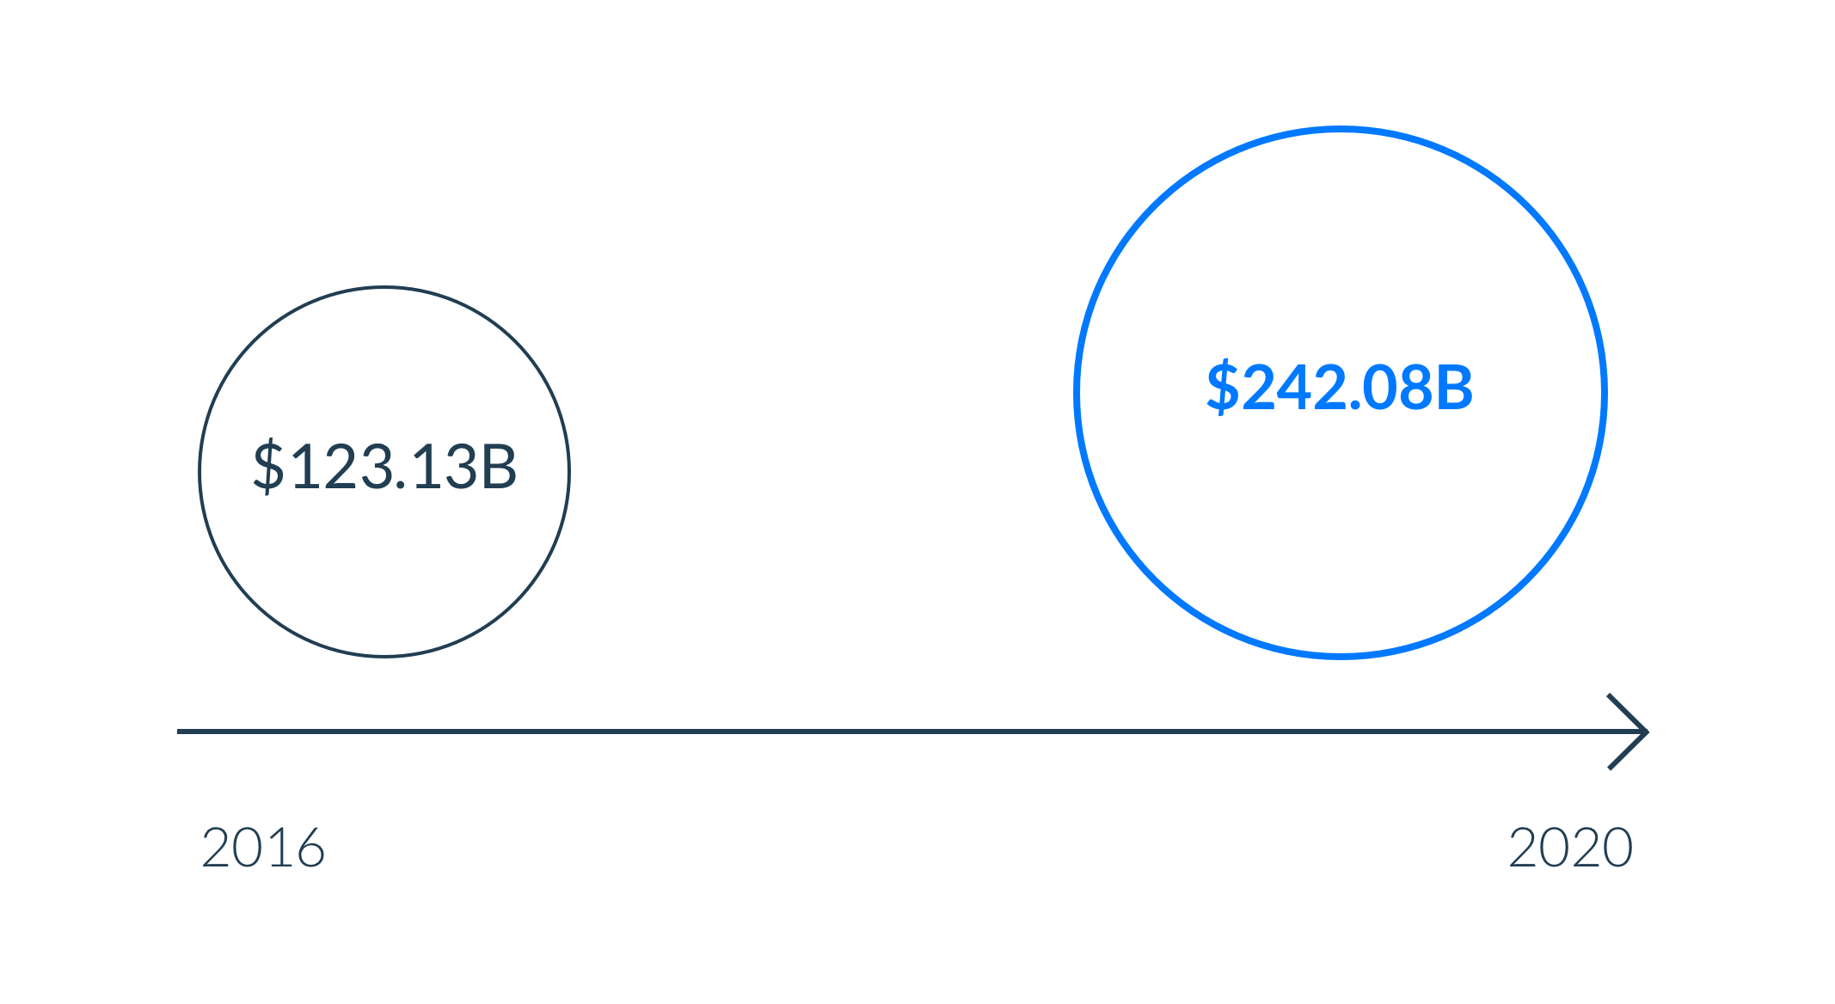
mCommerce Market
Source: eMarketer, Feb 2016

Slide 12
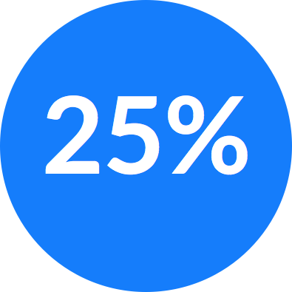
Unit Economics
Wholesale
5% convenience markup above MSRP
15% revenue share w/ the App
35% service fee to Tote, minus expenses:
Transaction Processing Company - 3%
Inventory and Fulfillment - avg. $2.75
Return Restocking - $0.20 at 7% return rate

Slide 13
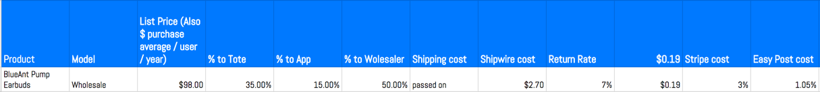
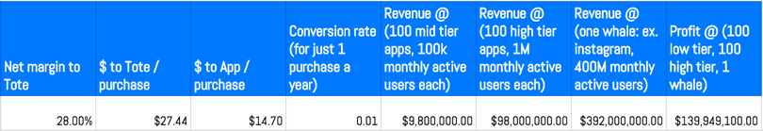
Unit Economics Example

Slide 14
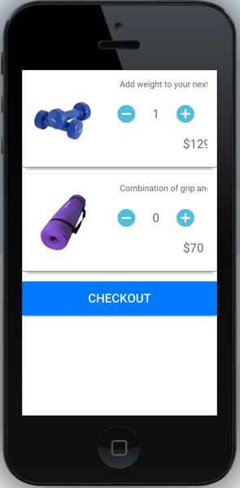
Tote Store
View as web-app
View in ios emulator

Slide 15
Tech Stack
Clutch
Ionic / Angular / Node
Heroku
Trie
Foundation / Saas
React
Heroku
API
Python / Flask
jsonapi
Integrations
Stripe
EasyPost
Shipwire

